Slide 1
DSC 640 – Week 9 & 10 Michael Ersevim

Slide 2
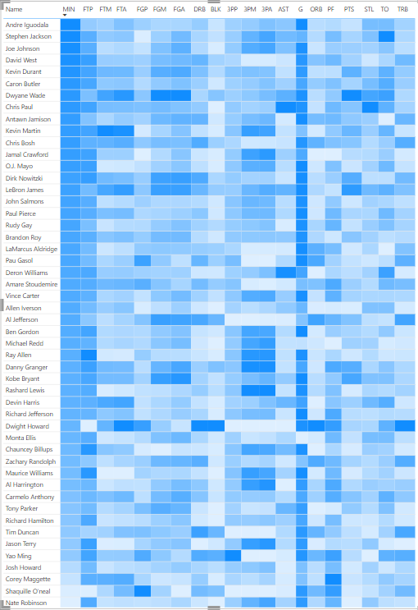
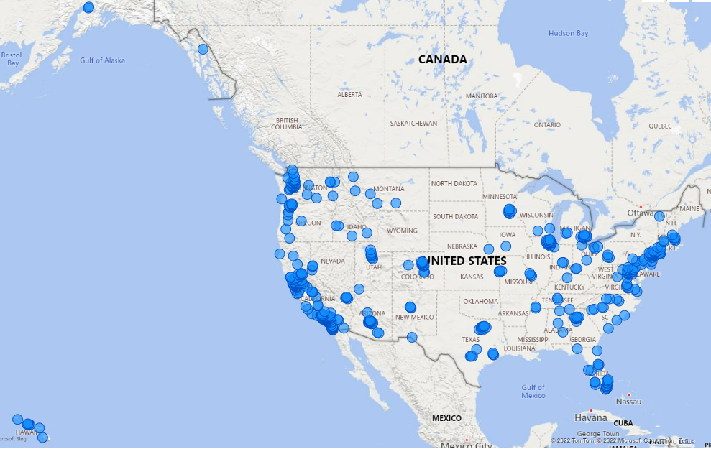
Power BI: Heat Map and Spatial Map
Left:
A Heat map of top NBA players and their common game statistics relative to each column’s high/low values regardless of value
Below: A spatial map of Costco locations across the United States

Slide 3
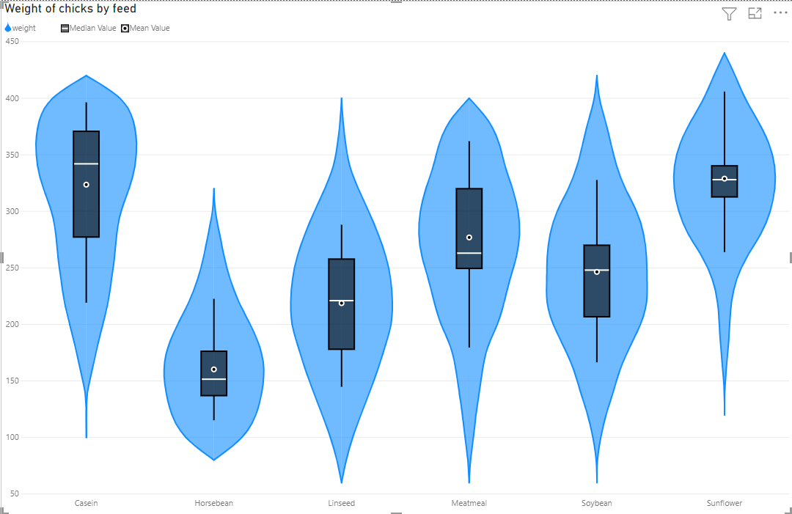
Power BI: Violin Plot
Violin plot of weight (in grams) of different groups of chicks being fed a certain feed type

Slide 4
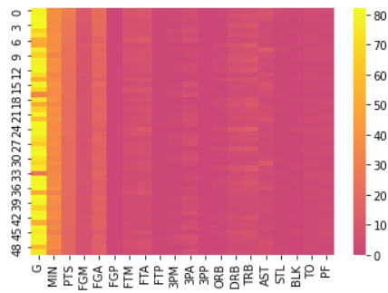
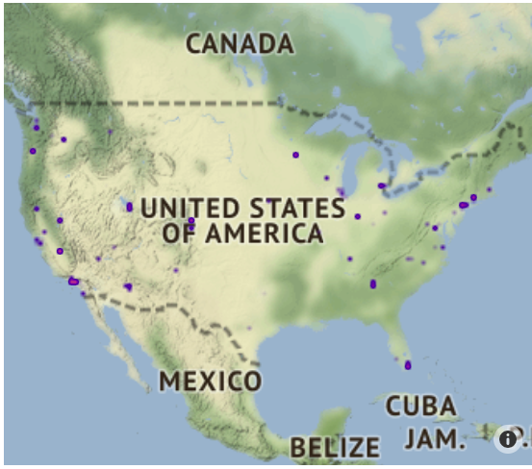
Python: Heat Map and Spatial Map

Slide 5
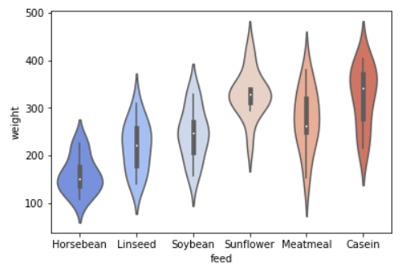
Python: Violin Plot

Slide 6
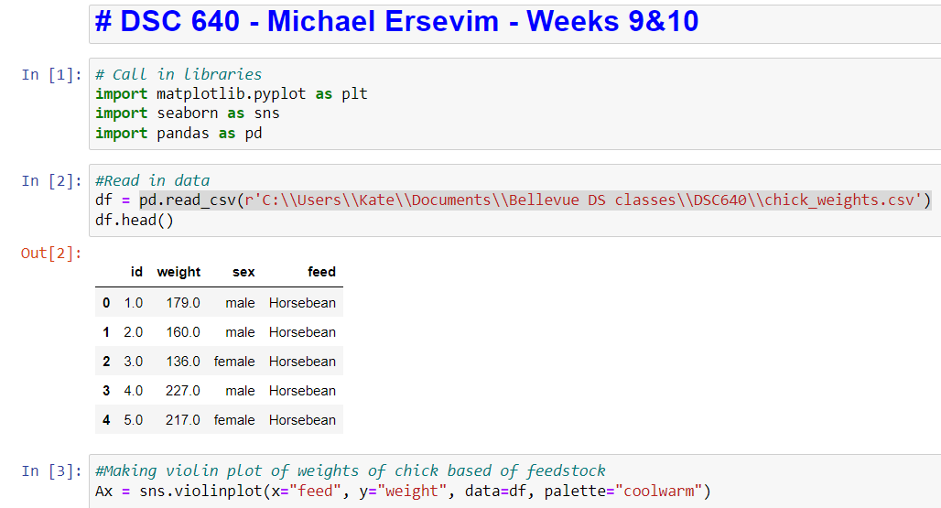
Python: CODE for generating graphs

Slide 7
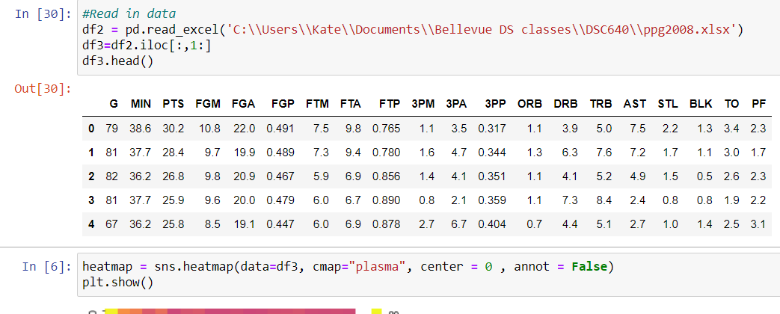
Python: CODE for generating graphs

Slide 8
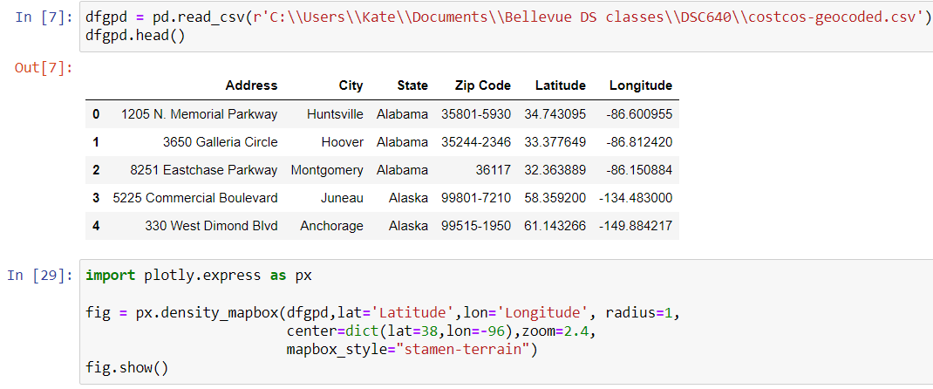
Python: CODE for generating graphs

Slide 9
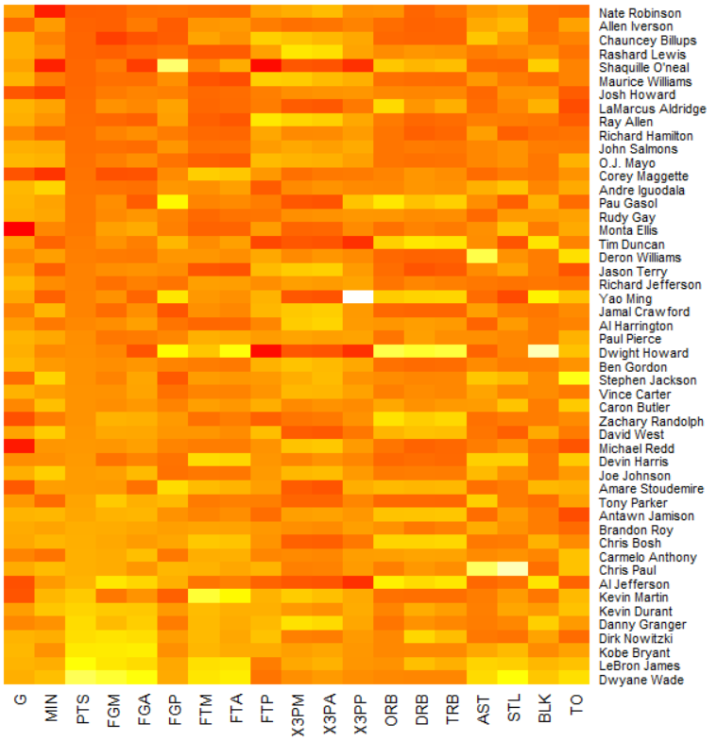
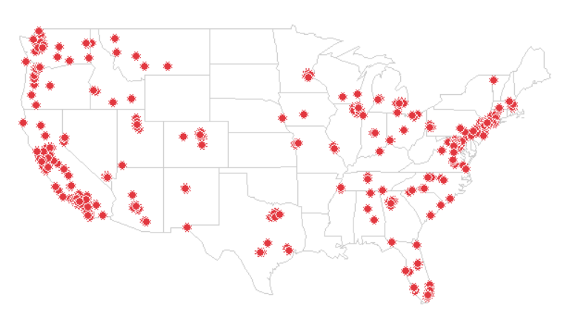
R: Heat Map and Spatial Map
Heat map of NBA player’s stats
Spatial map of CostCo locations across the United States

Slide 10
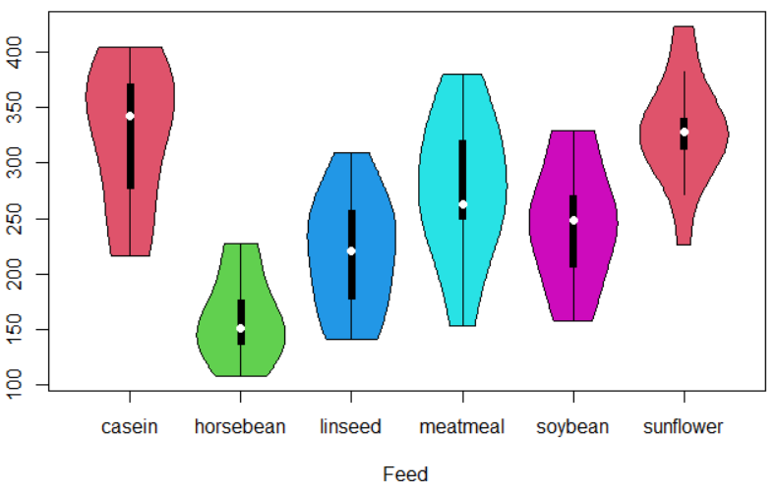
R: Violin Plot
Violin Plot of Chick weight in grams by feed type

Slide 11
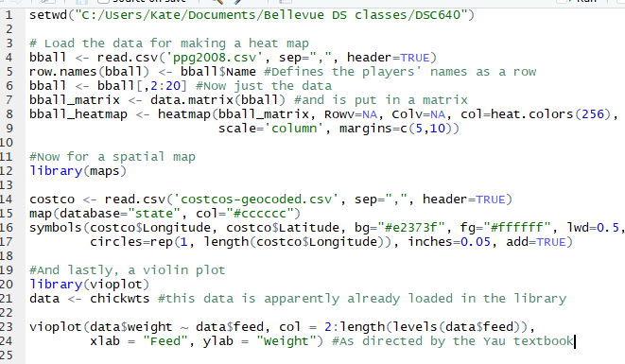
R: CODE for generating graphs

